Slide 1
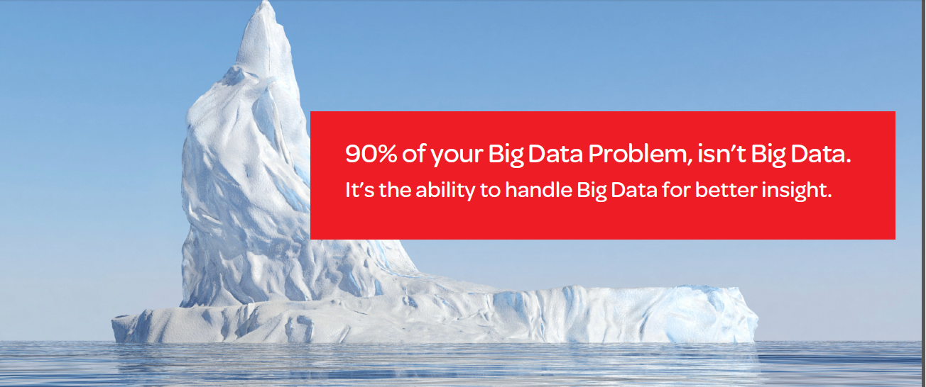

HPCC Systems
Flavio Villanustre
VP, Products and Infrastructure
HPCC Systems
Risk Solutions

Slide 2
INTRODUCTION
LexisNexis Risk Solutions
More than 15 years of Big Data experience
Provides information solutions to enterprise customers
Generates about $1.4 billion in revenue
Has been using the HPCC Systems platform for over 10 years
HPCC Systems
Launched in June 2011
Open source, and enterprise-proven distributed Big Data analytics platform
To help enterprises manage Big Data at every step in the Complete Big Data Value Chain
2

Slide 3
THE COMPLETE BIG DATA VALUE CHAIN
Collection
Ingestion
Discovery & Cleansing
Integration
Analysis
Delivery
Collection – Structured, unstructured and semi-structured data from multiple sources
Ingestion – loading vast amounts of data onto a single data store
Discovery & Cleansing – understanding format and content; clean up and formatting
Integration – linking, entity extraction, entity resolution, indexing and data fusion
Analysis – Intelligence, statistics, predictive and text analytics, machine learning
Delivery – querying, visualization, real time delivery on enterprise-class availability
3

Slide 4
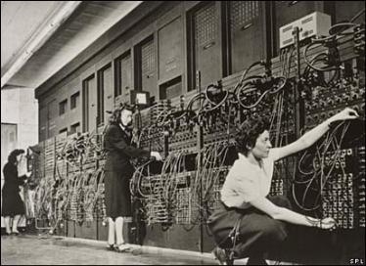


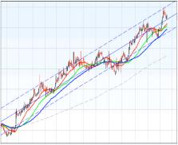
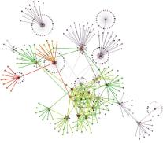

MACHINE LEARNING IN BIG DATA
How do you extract value from big data?
  You surely can’t glance over every record;
  And it may not even have records…
What if you wanted to learn from it?
  Understand trends
  Classify into categories
  Detect similarities
  Predict the future based on the past… (No, not like Nostradamus!)
Machine learning is quickly establishing as an emerging discipline.
  But there are challenges with ML in big data:
    Thousands of features
    Billions of records
    The largest machine that you can get, may not be large enough…
Get the picture?

Slide 5
ECL-ML: HPCC SYSTEMS MACHINE LEARNING
A fully distributed and extensible set of Machine Learning techniques for Big Data
State of the art algorithms in each of the Machine Learning domains, including supervised and unsupervised learning:
  Correlation
  Classifiers
  Clustering
  Statistics
  Document manipulation
    N-gram extraction
    Histogram computation
    Natural Language Processing
Distributed and parallel underlying linear algebra library

Slide 6
TAKE AWAYS
A fully parallel set of Machine Learning algorithms on Big Data gives you full insight
Outliers matter, especially when those outliers are the exact reason for the discovery effort (for example, in anomaly detection)
Dimensionality reduction can conduce to information loss: why risk losing valuable information when you can have it all?
Leveraging a fully parallel machine learning solution on Big Data will help you identify fraud, bring products to market faster, and become more competitive
Organizations that don’t leverage the big data that they have, risk losing ground to their competitors
Get on it, now!

